Slide 1
ProGramming Task report
Eshaan Sharma

Slide 2
Tasks Done
Task 0 - Generated 3 Data sets as specified
Task 1 - Achieved 99.8 percent accuracy on Hard Data Set
Task 2 – Achieved Maximum of 88 percent accuracy

Slide 3
Task 0 – Generating Easy data set
Produces simple CAPTCHAs on a white background using a fixed font.
Run easy.py to generate data set
Dataset Generation: The function is built to generate a large number of captcha images (default 10,000) automatically, ensuring consistency in the dataset creation process.
Font Selection: A system font (Helvetica.ttc) is chosen for consistency. The fixed font path and size (40) ensure that all images use the same text style, which can be useful for downstream tasks like training machine learning models.
Randomization of Captcha Text:
The length of the captcha text is randomized between 5 and 10 characters.
The first character is chosen as an uppercase letter with subsequent characters in lowercase. This introduces controlled variability, making each captcha unique while maintaining a simple pattern.
Image Creation and Styling: A new image is generated with a white background (400x200 pixels) and text is drawn in black. This clear contrast enhances readability.
Text Centering: The code computes the bounding box of the text and calculates the position necessary to center it within the image. This ensures visual consistency across all generated images.

Slide 4
Task 0 – Generating Hard data set
Run hard.py to Generate single image for each label
Run hard_variations.py to generate multiple images for each Label
Textured Background Generation:
Uses a base light random color with noise added via NumPy operations. ,
Noise is generated in a range (-30, 30) to subtly vary the background texture while keeping it legible.
Font Management:
A list of potential fonts is provided.
The code filters out fonts that don't exist on the system, ensuring robustness.
Different random fonts are selected on a per-character basis for increased variation (especially in the hard variations dataset).

Slide 5
Text Variation:
Implements random capitalization to produce natural variation.
Two approaches are present: one varies the entire word while the other applies per-character randomness within a generated base word.
Dynamic Font Sizing and Spacing:
Font sizes are determined based on text length and available image space to maintain consistent aesthetics.
The code randomly varies character and edge padding to avoid uniformity, resulting in more diverse captchas.
Character Rendering:
First pass calculates each character’s dimensions using draw.textbbox to get precise metrics.
Second pass renders each character onto an RGBA image for accurate positioning (accounting for left/top bearings).
The rendered character images are pasted onto the main image, ensuring each character maintains its own unique styling.
Effects Application:
Random application of Gaussian blur and edge enhancement filters simulates distortions.
The process combines subtle blurs and enhancements to mimic noise or scanning artifacts.

Slide 6
Task 0 -Bonus
Noisy Background Creation:
Uses NumPy for efficient noise generation.
Applies a noise range (-20, 20) to a base color image and clips values to maintain valid RGB values.
Color-Based Logic:
Two background colors are defined ("red" and "green").
The text is reversed for red backgrounds to introduce a variation based on color, adding complexity to the captcha.
Font Handling:
A list of potential fonts is provided and filtered by existence, ensuring only available fonts are used.
Randomly selects both the font file and its size (between 40 and 60) for variability.
Text Generation and Styling:
Random text is generated with a length between 5 and 10 characters, with randomized case per character.
Centers the text in the image by calculating its bounding box.
Adds a slight shadow (offset by 2 pixels) to improve text readability against noisy backgrounds.
Image Effects:
Conditionally applies Gaussian blur (30% probability) to further vary the captcha appearance.

Slide 7
Task 1 -Classification
Select a subset of your generated dataset containing only 100 words from both the hard and easy sets. Then, train a neural classifier to classify images into one of these 100 labels. Experiment with the number of samples required to obtain reasonable accuracy and report a thorough scientific evaluation of your model. Mention any challenges you faced in trying to train this model and explain how you overcame them.
First Started by implementing a simple neural network to check baseline and how it compares to a CNN

Slide 8
Simple Feed Forward Neural Network Implementation
Model Architecture
Layered MLP: The classifier uses a multilayer perceptron (MLP) with several fully connected (Linear) layers. The image is first flattened and then passed through four blocks, each consisting of a Linear layer, a ReLU activation, and a Dropout layer to reduce overfitting.
Output Shape: The final output layer reshapes the prediction into a tensor of shape (batch_size, max_length, vocab_size), which is appropriate for sequence-based captcha prediction.
Weight Initialization: Xavier (Glorot) initialization is applied to the linear layer weights to ensure stable gradients during training.
Data Handling and Preprocessing
Custom Dataset & Transformations: The images are loaded via a custom dataset (CaptchaDataset) that applies transformations such as image resizing, conversion to tensor, and grayscale filtering.
Variation Control: The function load_dataset_with_variations groups images by labels and limits the number of samples per label (if specified). This helps in balancing the dataset and reducing biases from overly frequent examples.
Training and Evaluation
Data Splitting: The dataset is split into training, validation, and test sets using PyTorch’s random_split utility, ensuring unbiased evaluation.
Device Selection: The code automatically selects a GPU if available, otherwise falls back to using the CPU, enabling flexibility and performance on different systems.
Training Loop: The training, evaluation, and analysis functions (imported from captcha_classifier) guide the model training process with proper metric tracking.

Slide 9
Results
Terrible results
accuracy: 0.0000 precision: 0.0000 recall: 0.0000 f1: 0.0000

Slide 10
A simple CNN for Easy Dataset
Input The model expects grayscale images (1 channel) with a fixed size defined by IMG_SIZE. This size is used to create a dummy tensor for dynamically computing the flattened feature size.
Convolutional Blocks The network has three consecutive convolutional blocks:
Block 1: • Conv2d with 1 input channel and 32 output channels, kernel size 3, stride 1, and padding 1. • ReLU activation. • MaxPool2d (2×2) to downsample the feature maps.
Block 2: • Conv2d: 32 → 64 channels using the same kernel and padding parameters. • ReLU activation. • MaxPool2d (2×2).
Block 3: • Conv2d: 64 → 128 channels. • ReLU activation. • MaxPool2d (2×2).
Dynamic Flattened Size Calculation A sample input is passed through the conv layers (inside a with torch.no_grad() block) to determine the flattened feature dimensionality. This design avoids hardcoding feature sizes and adapts to the chosen image dimensions.

Slide 11
A simple CNN for Easy Dataset
Fully Connected Layers After flattening:
A linear layer projects the features to 512 dimensions followed by a ReLU.
A final linear layer maps the 512 features to NUM_LABELS outputs (e.g., 100 labels for CAPTCHA classification).
Loss and Optimization
Uses CrossEntropyLoss, which is appropriate for classification tasks as it expects class indices.
The optimizer is Adam, with a learning rate (LEARNING_RATE) specified externally.
Training and Evaluation The training loop accumulates metrics per epoch:
Accuracy is computed by comparing the predicted labels (using torch.max) with true labels.
Additional metrics computed include precision, recall, F1 score, and a confusion matrix.
The evolution of loss and accuracy is plotted at the end for visualization.

Slide 12
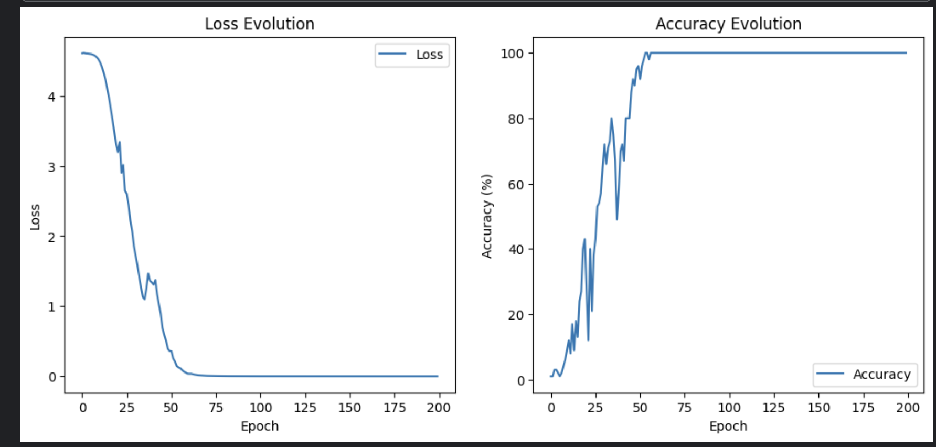
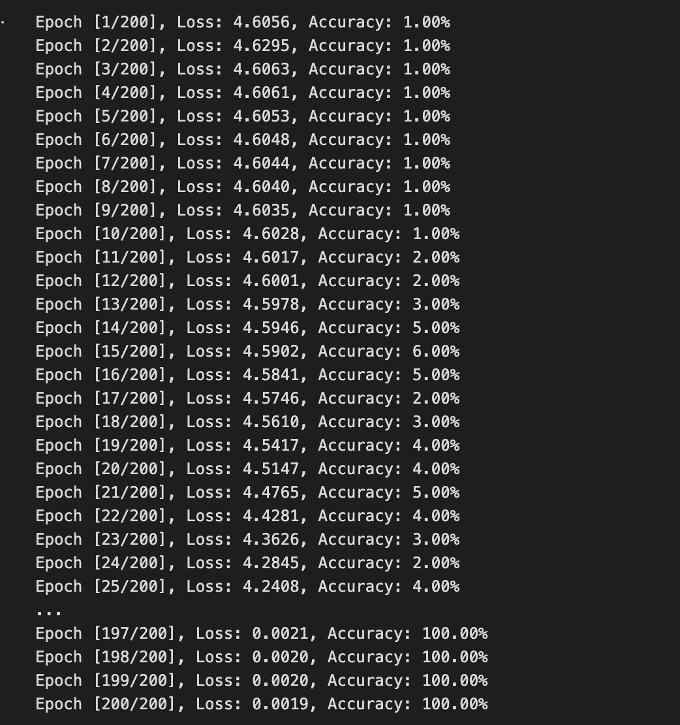
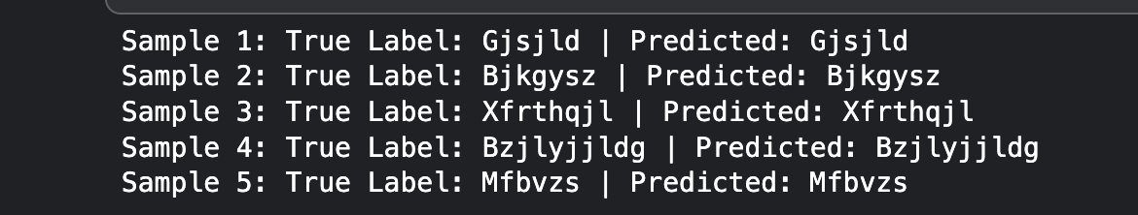
A simple CNN for Easy Dataset

Slide 13
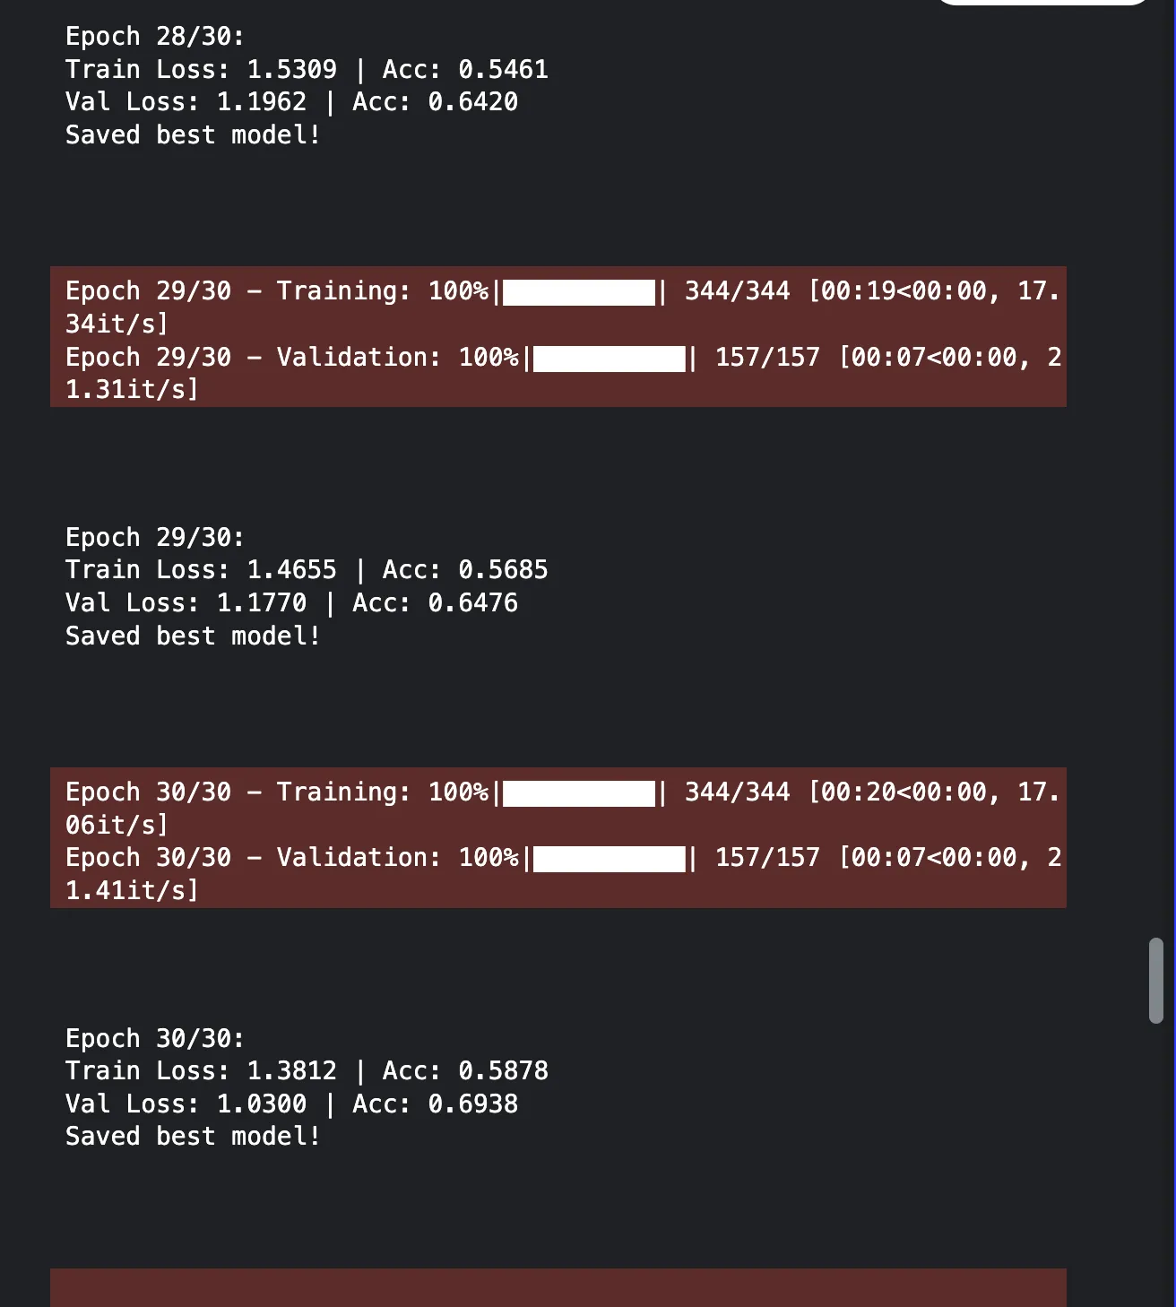
Simple CNN on the Hard Data set
Training the previous model on the hard data set
Got 69 percent accuracy
Might get better accuracy if trained for longer
The model can still be made more efficient

Slide 14
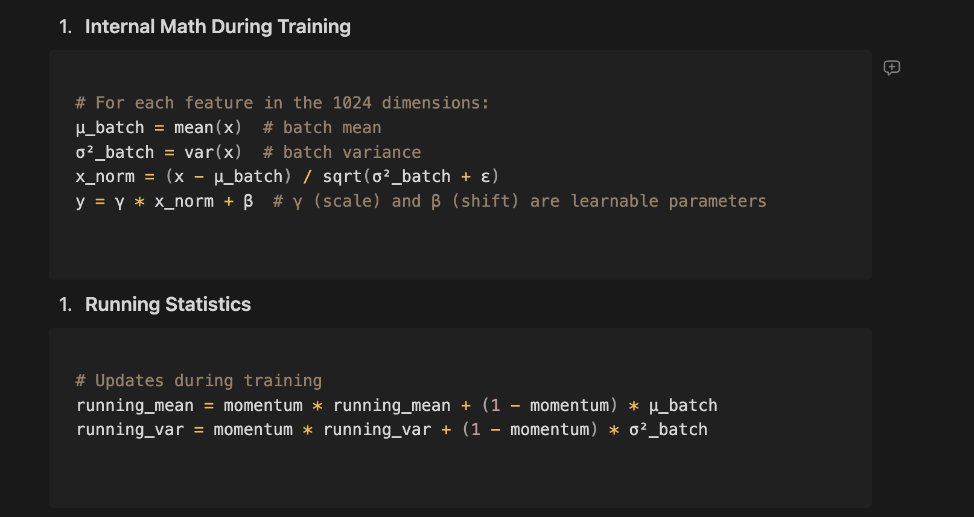
Adding Batch Normalisation and Dropout
What batch normalization does ==>
Effects on Training
Gradient Flow
Reduces vanishing/exploding gradients
Each layer can learn more independently
Learning Rate
Allows higher learning rates
More stable training
Feature Scaling
Dropout adds regularisation to the CNN

Slide 15
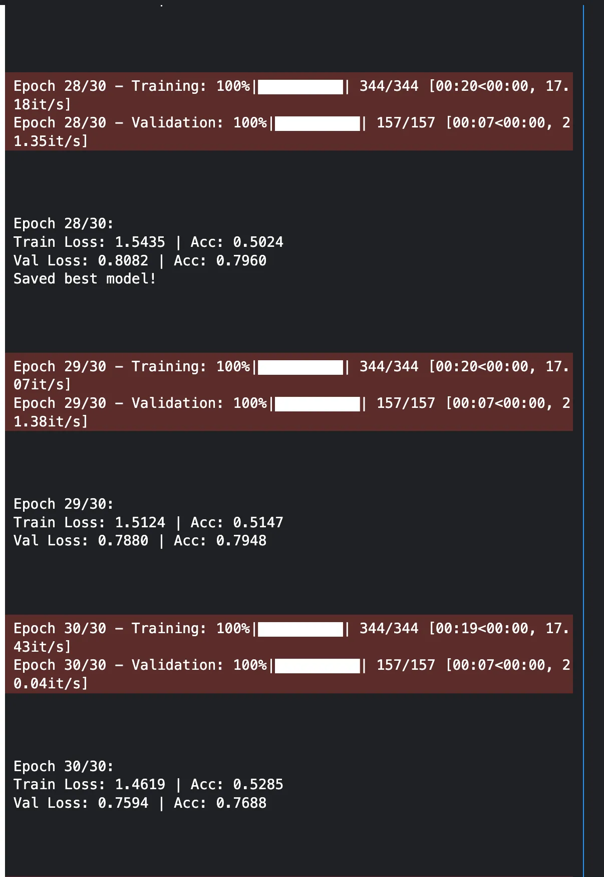
Results
Accuracy Increased to 77% , hence the model is learning better
Next we try to increase the network size

Slide 16
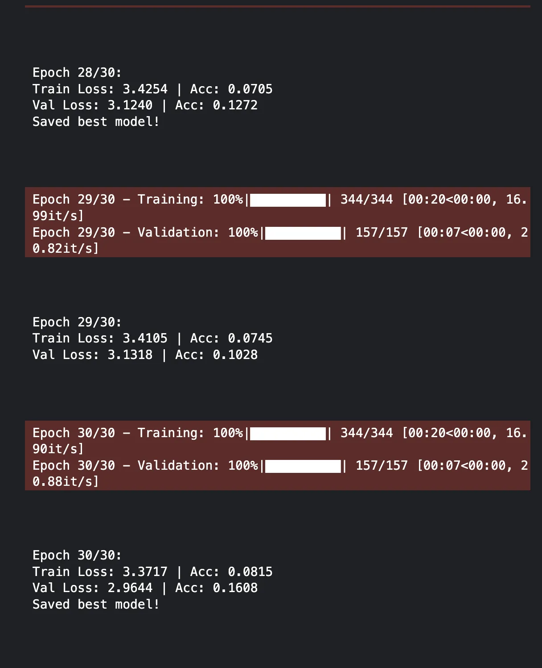
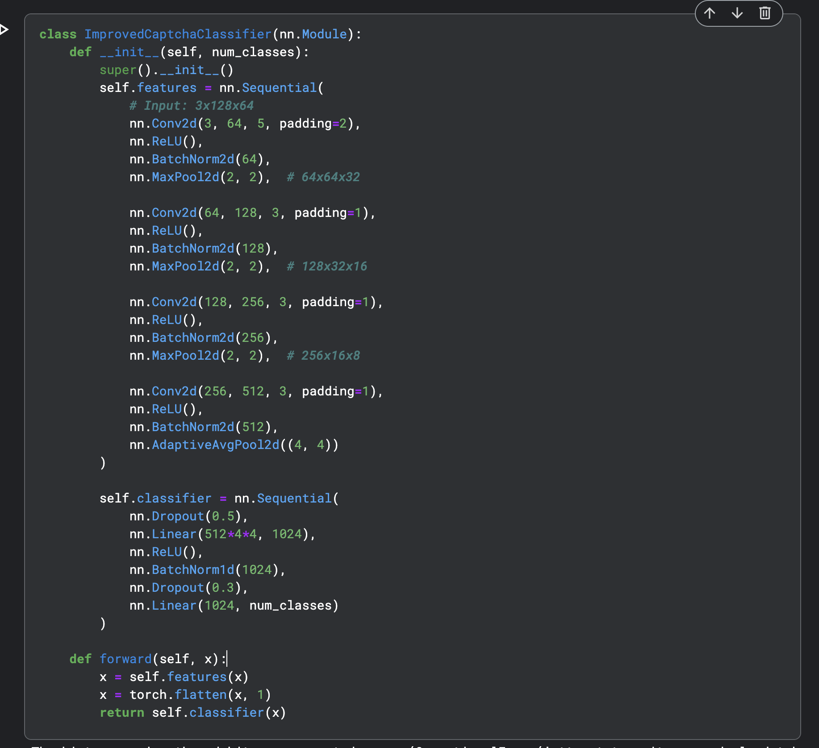
Increasing the Size of the network
Model learns much slower and is worse surprisingly (at least to me)
Hence the optimal size of the network appears to be the smaller one

Slide 17
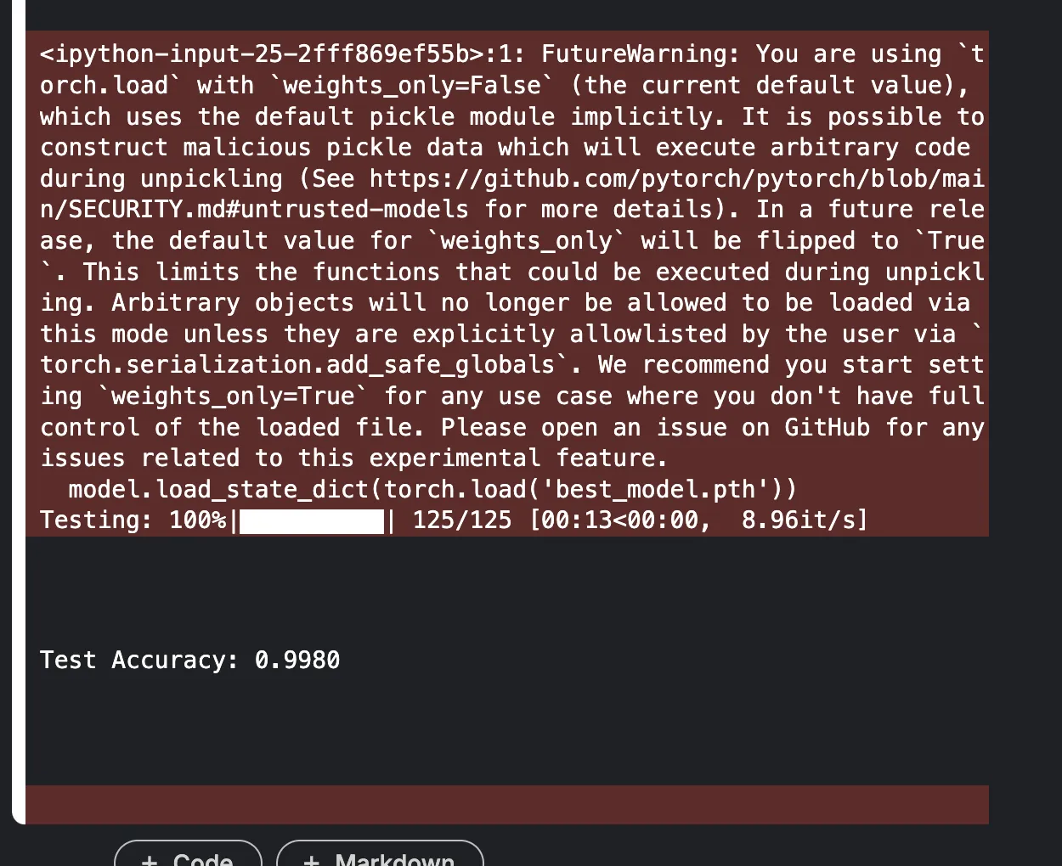
Using A smaller Network and adding Learning rate scheduling
This will be final model for Task 1 it give 99.8 percent accuracy on the test set
What is Learning Rate scheduling
Learning rate scheduling adjusts the optimizer’s learning rate during training to improve convergence. Typically, a high learning rate is useful early on to make substantial updates, while a lower learning rate later helps fine-tune the network. This dynamic adjustment can help avoid overshooting minima and often leads to faster or more stable convergence.

Slide 18
Final Implementation details for task 1
Design Decisions and Technical Details of the Captcha Classifier
1. Model Architecture Design
The CaptchaClassifier is a Convolutional Neural Network (CNN) designed for image classification, specifically for recognizing CAPTCHA characters. The design is influenced by best practices in deep learning for image-based tasks.
Feature Extraction (Convolutional Layers)

Slide 19
The model consists of four convolutional layers, progressively increasing the number of filters.
• Conv2d Layers:
• Layer 1: 3 → 32 filters
• Layer 2: 32 → 64 filters
• Layer 3: 64 → 128 filters
• Layer 4: 128 → 256 filters
• Batch Normalization: Applied after each convolution to speed up convergence and improve generalization by normalizing activations.
• ReLU Activation: Introduced non-linearity, enabling the model to learn complex patterns.
• MaxPooling Layers (2x2): Reduce spatial dimensions, making the model computationally efficent while preserving important features.

Slide 20
Fully Connected Layers (Classification Head)
After feature extraction, the output is flattened and passed through a fully connected network:
Linear(256 * 8 * 4, 512): Reduces dimensionality while retaining useful feature representations.
ReLU Activation: Introduces non-linearity to learn complex patterns.
Dropout (0.5 & 0.3): Helps prevent overfitting by randomly deactivating neurons during training.
Final Linear Layer: Maps the 512-dimensional vector to the number of classes (num_classes).

Slide 21
1. Mixed Precision Training
torch.cuda.amp.autocast(): Used for automatic mixed precision (AMP), which improves training speed and reduces memory consumption without compromising accuracy.
torch.cuda.amp.GradScaler(): Helps prevent underflow issues when using mixed precision by scaling gradients dynamically.
2. Training Pipeline
Optimizer: Adam optimizer with an initial learning rate of 0.0001 (set explicitly in epoch 0).
• Learning Rate Adjustment:
Learning rate starts at 0.0001 (manually adjusted in epoch 0).
Scheduler: A learning rate scheduler (scheduler.step()) is used to adjust the learning rate based on validation performance.
Loss Function: Cross-entropy loss, as this is a multi-class classification problem.

Slide 22
3. Model Evaluation & Best Model Selection
Accuracy Calculation: Tracks correct predictions for both training and validation datasets.
Best Model Saving:
The model with the highest validation accuracy is saved as best_model.pth.
• Helps ensure the best-performing model is preserved, preventing overfitting to the training set.

Slide 23
Design Rationale
1. Efficient Feature Extraction:
• The progressive increase in filters (32 → 64 → 128 → 256) allows the network to capture both low-level and high-level features effectively.
• Batch Normalization stabilizes training and speeds up convergence.
2. Regularization to Prevent Overfitting:
Dropout layers in the classifier reduce overfitting.
Batch Normalization helps by normalizing activations and reducing internal covariate shifts.

Slide 24
3. Scalability & Flexibility:
The model architecture is lightweight yet effective, making it suitable for CAPTCHA classification on devices with limited computational power.
Can be adapted to different character sets by modifying num_classes.
4. Optimized Training Strategy:
Mixed Precision (AMP) improves efficiency.
Gradient scaling prevents numerical instability.
Learning rate scheduling ensures optimal learning progression.
Summary
This design balances efficiency, performance, and robustness. It leverages deep CNNs for feature extraction, regularization techniques to prevent overfitting, and AMP for speed optimization.

Slide 25
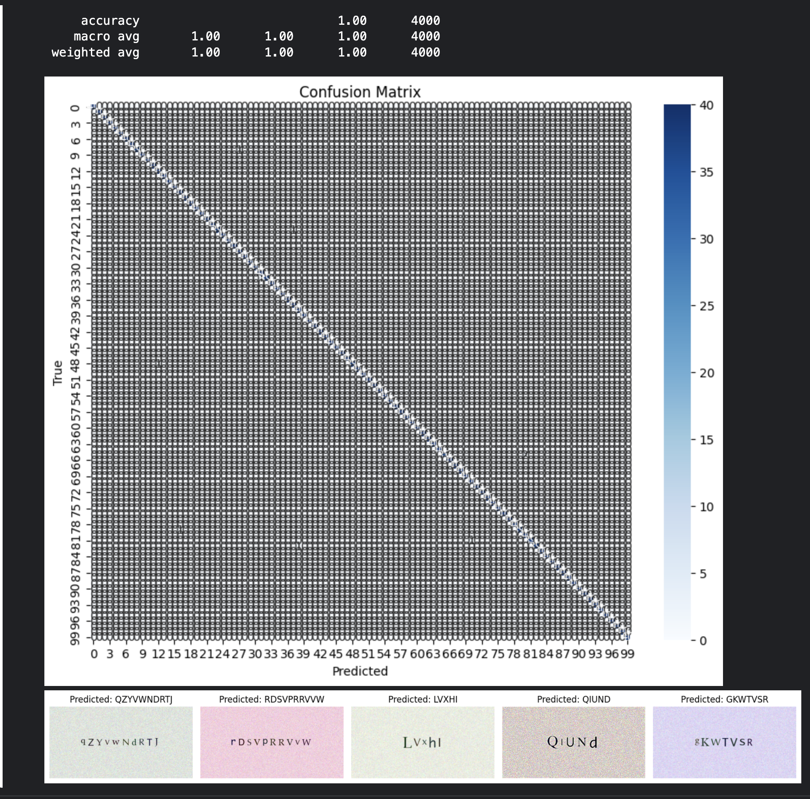
results

Slide 26
Task 2
In the real world, CAPTCHAs are unpredictable and do not belong to 100 easy classes. In this subtask, you will improve upon your architecture to extract the text itself present in the image i.e. we input the image, and the output is the text embedded in the image. Keep in mind that words can be of variable length, which you will need to account for. Be scientific in your evaluation. This task will require moderate tinkering with architectures and hyperparameters to achieve reasonable performance — document everything you’ve done. We do not expect you to solve this task entirely but we do expect meaningful forward progress.

Slide 27
Task 2 – Model1 Segmentation with CNN
Design Decisions and Technical Details
Character Segmentation (segment_characters):
Thresholding & Contours: Uses OpenCV’s Gaussian blur, Otsu’s thresholding, and contour detection to extract character regions, which helps in isolating individual characters from CAPTCHA images.
Alpha Channel Handling: Converts RGBA to RGB if necessary to ensure consistent processing.
Sorting: Bounding boxes are sorted left-to-right to match the natural text order.
Dataset Design (CaptchaCharDataset):
Filename-Based Labeling: Assumes filenames encode the correct text (e.g., "captcha_ABcd_...png") and parses them to generate labels.
Dynamic Sampling: Limits the dataset to 10,000 images if available to balance training time and dataset size.
Fallback Segmentation: If computed crops do not match expected character count, a fallback equal-width split is applied, ensuring robustness.

Slide 28
Model Architecture (CharacterClassifier):
Feature Extraction: Three sequential convolutional blocks with Batch Normalization, ReLU activations, and MaxPooling are used to extract hierarchical features from character images.
Fully Connected Layers: A dropout-regularized classifier projects the flattened features into a 256-dimensional space before producing logits for 52 classes (uppercase + lowercase).
Rationale: The depth and pooling operations provide sufficient representational capacity while managing overfitting through dropout layers.
Training and Validation:
Loss and Optimization: Utilizes CrossEntropyLoss with the Adam optimizer and learning rate scheduler (ReduceLROnPlateau) to adapt the learning rate based on validation performance.
Metrics Tracking: Computes loss and accuracy per epoch to monitor training progress.
Evaluation Functions:
Character vs. Word Level Accuracy: Separate functions for per-character evaluation and full CAPTCHA (word) evaluation highlight both local and holistic model performance.
Visualization: Use of confusion matrices (using Seaborn) and classification reports provides detailed insights into model errors.
Example Predictions: Visualizes correctly and incorrectly predicted words, aiding qualitative assessment of segmentation and classification performance.
Device Support and DataLoader Configuration:
Platform Adaptability: Automatic device selection for Apple M1 (MPS), CUDA, or CPU ensures optimal performance.
Dataloader Settings: Configures num_workers and pin_memory based on the device type to optimize loading performance.

Slide 29
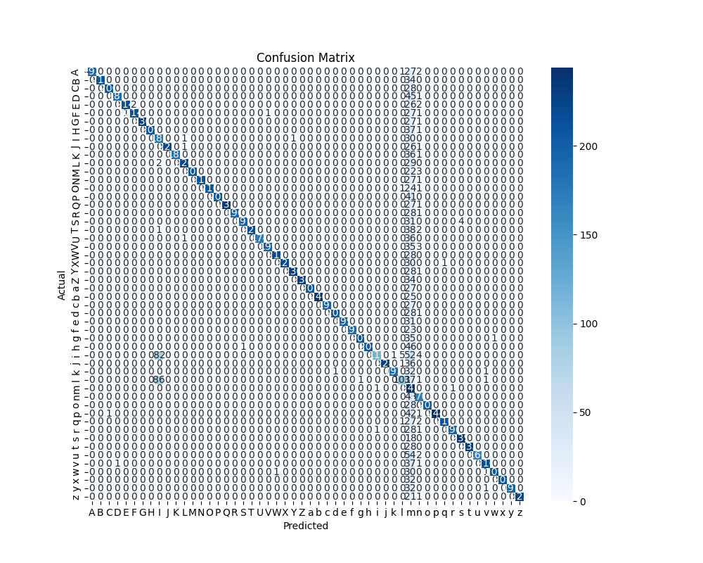
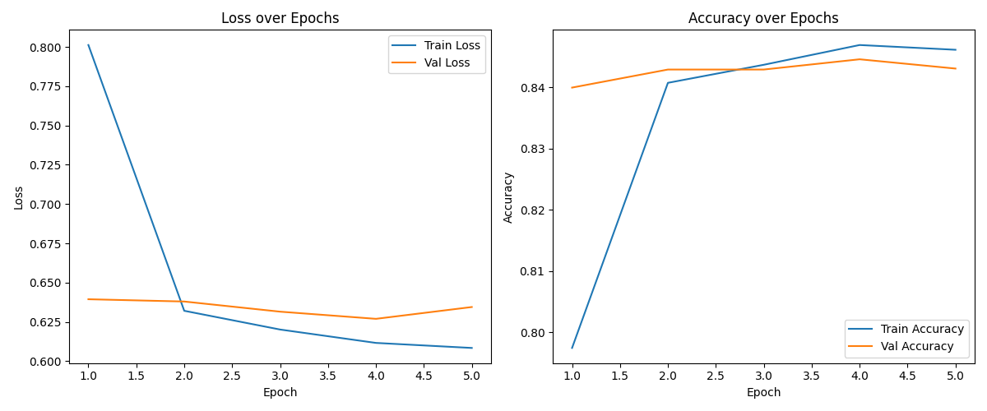
Results

Slide 30
Attempt 2 CRNN
CRNN Model Architecture:
CNN Feature Extractor: The model starts with multiple convolutional layers to extract visual features from the images. Max pooling is applied at different stages to reduce spatial dimensions. Adaptive average pooling forces the feature map height to 1, making the width dimension represent a sequence.
Sequence Modelling: An LSTM network is applied to the sequence, treating the width dimension as time steps. The bidirectional LSTM captures dependencies in both directions.
Final Projection: A fully connected layer converts LSTM outputs into class probabilities for each time step, preparing the output for the CTC loss which expects sequence outputs.
Training and Validation Functions:
train_one_epoch: Iterates over training batches, encodes target labels using LabelConverter, computes the CTC loss, performs backpropagation, and updates model weights.
validate: Similar to training but without weight updates. Additionally, this function decodes predictions using the converter, computes word-level accuracy, and aggregates loss for monitoring.

Slide 31
CTC Loss Usage: The use of the CTC (Connectionist Temporal Classification) loss accommodates variable-length outputs and the alignment issues typical in sequence recognition tasks without requiring pre-segmented data.
Combination of CNN and RNN: The CRNN design leverages CNNs for spatial feature extraction and RNNs (LSTM) for modeling sequential dependencies. The transformation of the CNN’s output with adaptive pooling to a one-row feature map allows a natural sequence interpretation.
CTC-based CRNN models combine CNNs for spatial feature extraction with RNNs (LSTMs) for capturing sequential context. This architecture is well-suited for tasks like captcha recognition where the sequence length can vary and direct alignment between input and target labels is unknown. The CNN extracts robust features from the image, and the RNN (LSTM) processes these features as a time sequence. The CTC loss then flexibly aligns the RNN outputs to the target label sequence without requiring explicit segmentation or alignment.

Slide 32
Initial Run
NO training progress
Train Loss: 4.3435 | Val Loss: 4.4624 | Val Word Acc: 0.0000 Avg Edit Distance: 6.2796 | CER: 1.0000
Same case for 5 more epochs
Model wasn’t learning

Slide 33
Changes Made to Initial Model
. Hyperparameter tweaks:
• A lower learning rate (0.0005 instead of 0.001)
• Slightly reduced weight decay (1e-6 instead of 1e-5)
2. Decoding strategy update:
In addition to the original greedy decoding, added an alternative beam search decoder.
The beam search decoding function (beam_search_decoder_single) is a simple (though not fully optimal) implementation that works in the log domain. It processes each time step’s log probabilities (computed via torch.log_softmax()) and returns a decoded string after post‐processing (removing duplicate characters and blanks).

Slide 34
More changes
1. Model Changes & Regularization:
• The CRNN model now includes a dropout layer (set by dropout_rate=0.6) before the final fully connected layer.
2. Variable Learning Rate Scheduling:
• The training loop uses OneCycleLR. The scheduler is stepped after every batch inside train_one_epoch().
• Total steps are computed as num_epochs * len(train_loader), and the maximum learning rate is set to 0.005.

Slide 35
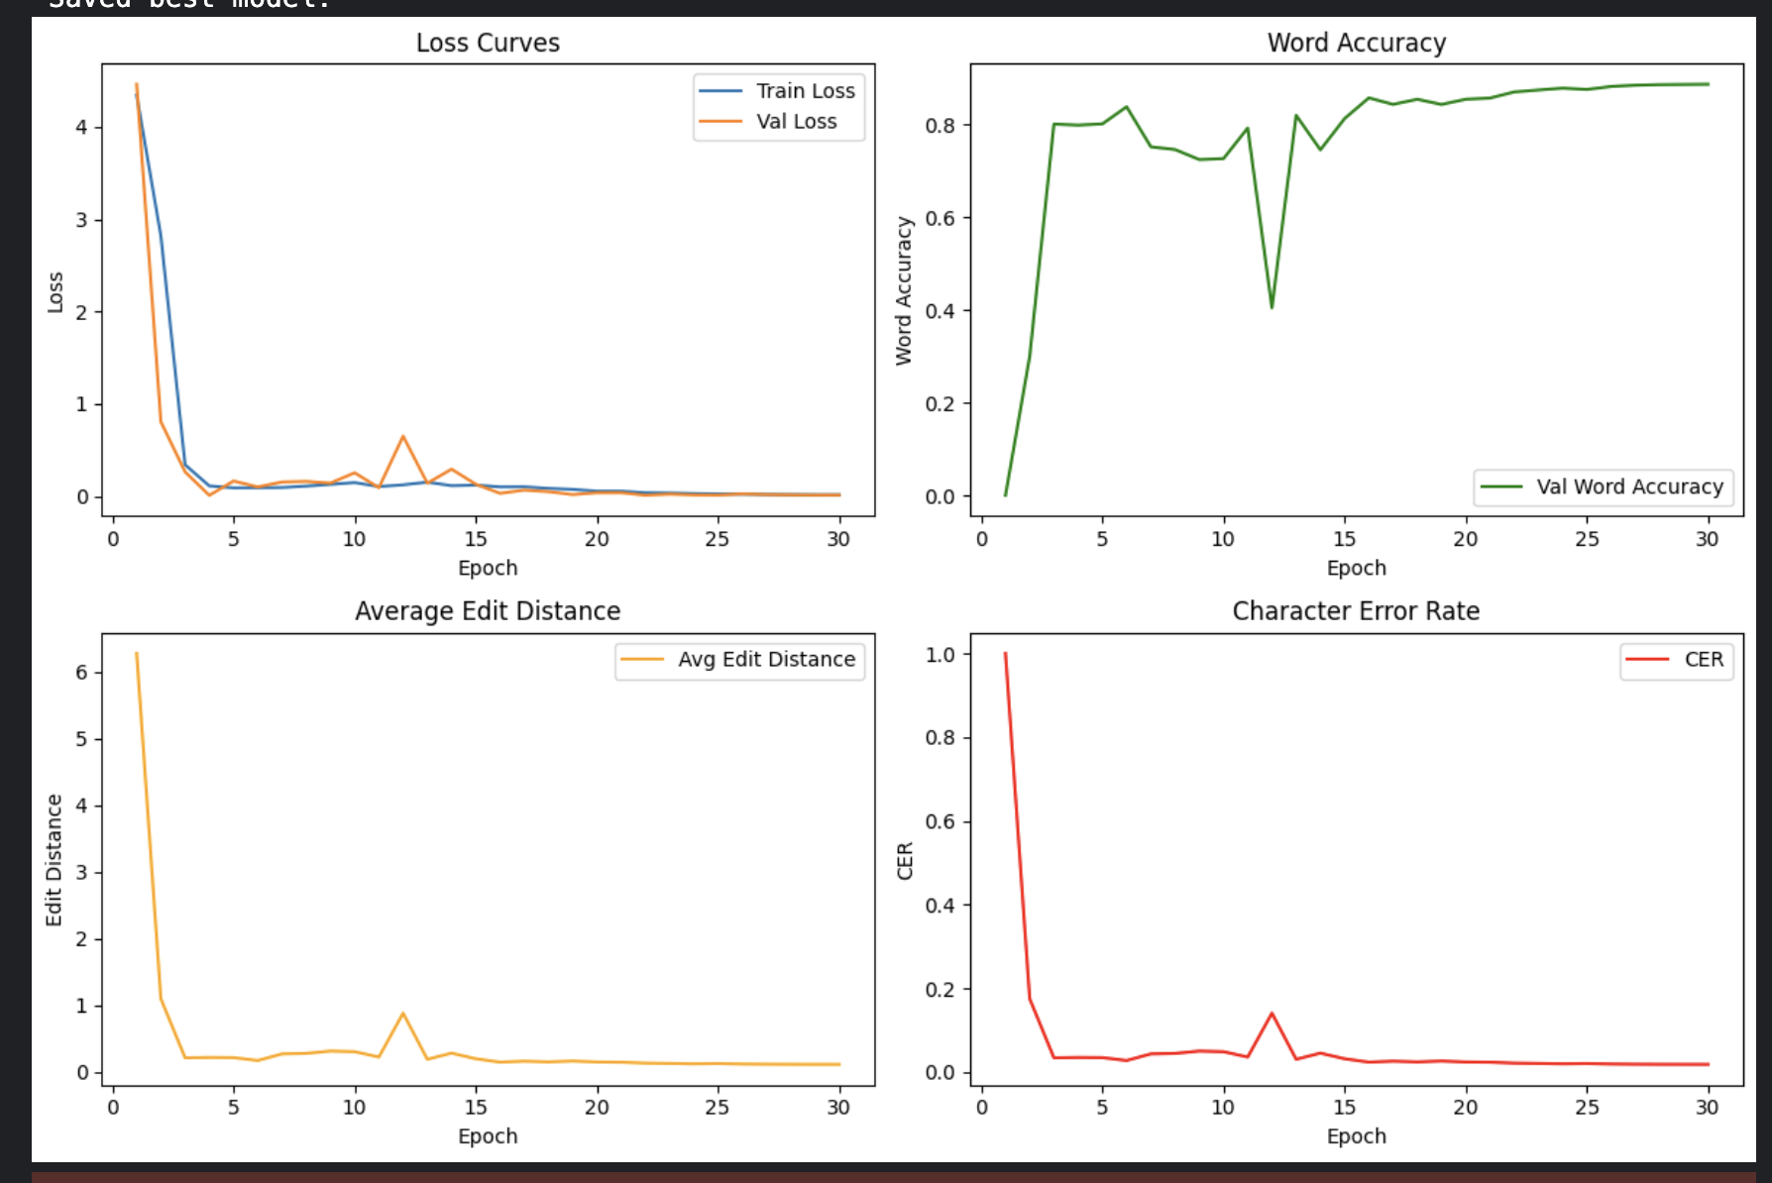
Results – The model learns much better

Slide 36
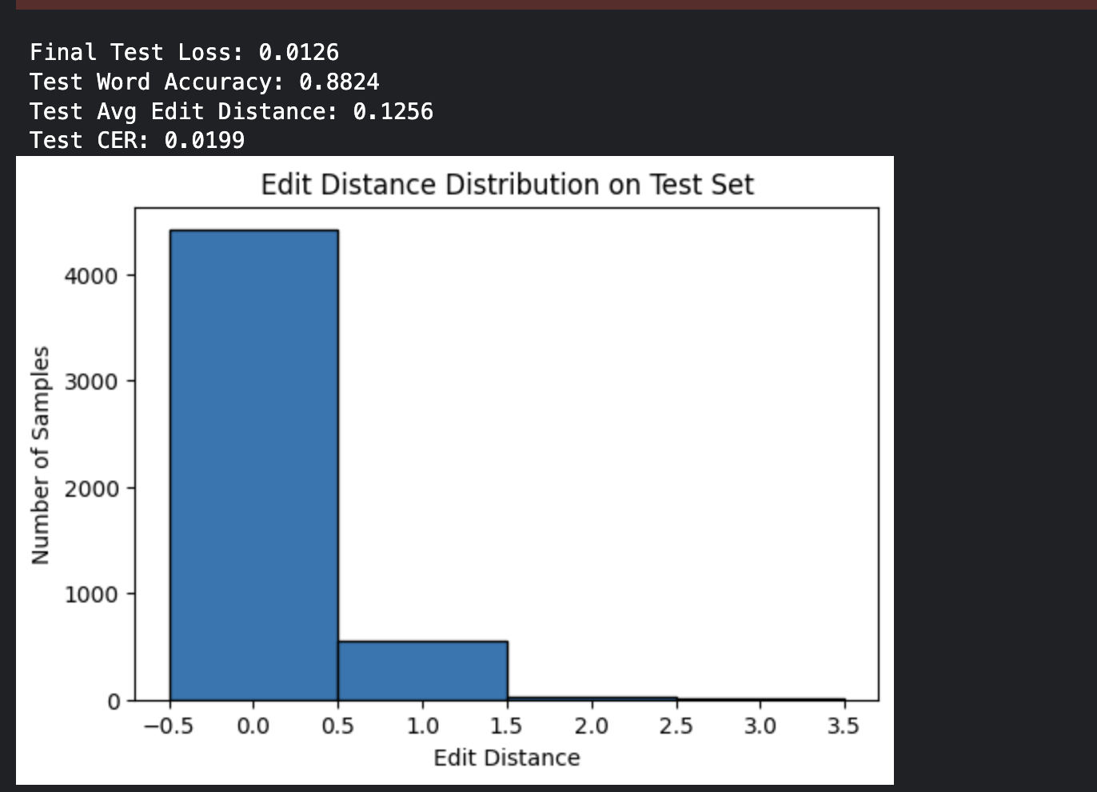
Results Continued

Slide 37
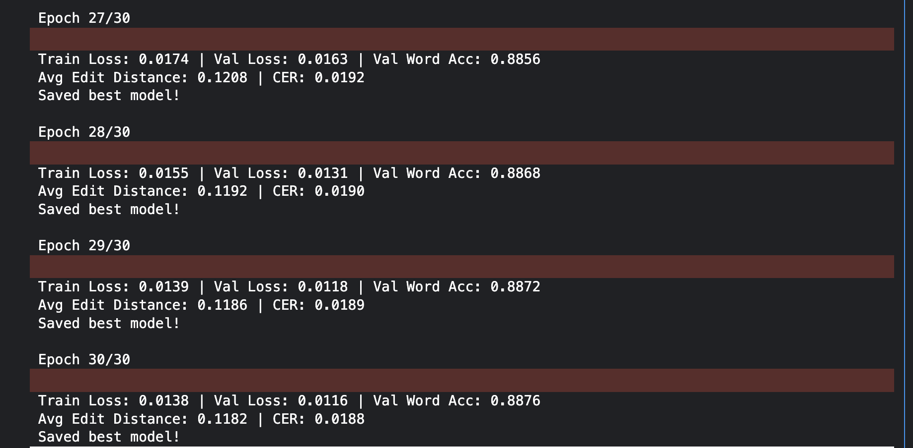
More Results
Sample Test Predictions: GT: kVnMvXn | Predicted: kVnMvXn GT: QDhd | Predicted: QDhd GT: ynmJRVnG | Predicted: ynmJRVnG GT: zQIJFEt | Predicted: zQIJFEt GT: yUNKuovLP | Predicted: yUNKuovLP GT: DsZGGv | Predicted: DsZGv GT: BnicF | Predicted: BnicF GT: pgvqo | Predicted: pgvqo GT: FosKFYS | Predicted: FosKFYS GT: jeTybX | Predicted: jeTybX

Slide 38
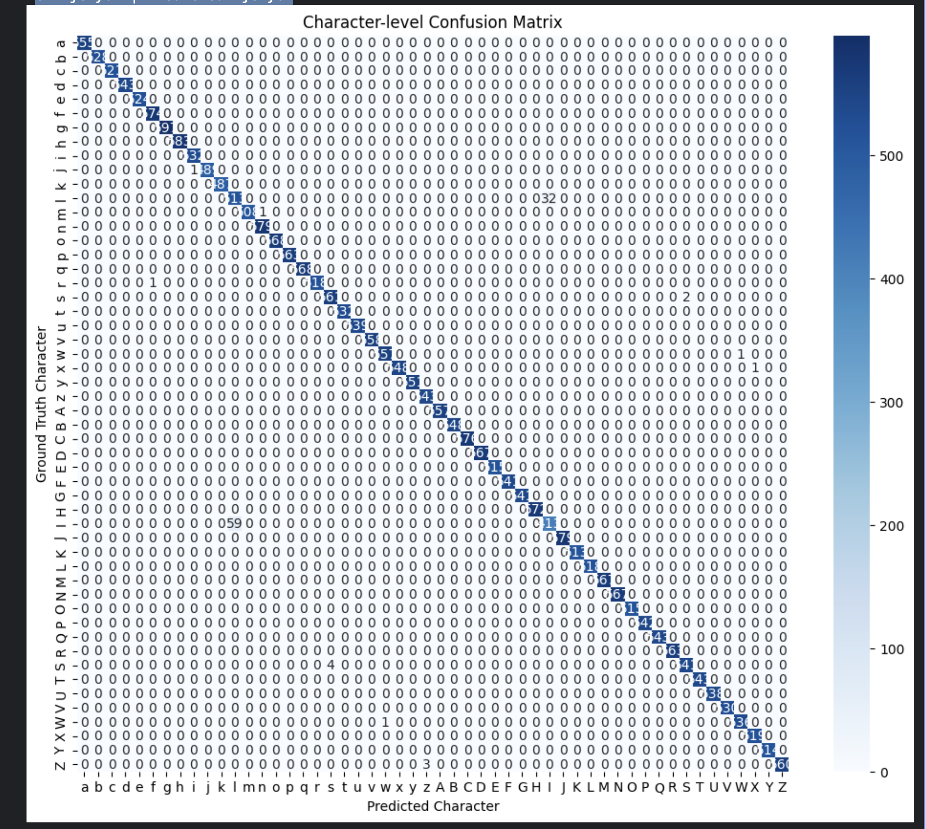

Slide 39
Adding an Attention Layer
Unsuccessfully tried implementing the Encoder Decoder architecture mentioned in the papers https://arxiv.org/pdf/2409.01704
https://arxiv.org/abs/2103.00020
Initially independently got the idea from the reading task paper , on further research discovered the encoder decoder architecture which is basically in this case an CNN with RNN(LSTM) with an additional attention layer

Slide 40
Implementation Details
Vocabulary & Label Conversion:
The vocabulary includes special tokens (<pad>, <sos>, <eos>) along with all letters.
The converter automatically prepends <sos> and appends <eos> to each sequence.
This design enables easy sequence generation and facilitates training with sequence-to-sequence (seq2seq) models.
Dataset & Collate Function:
The dataset reads captcha images and extracts labels from filenames.
The collate function:
Stacks images.
Encodes text labels into sequences of token indices.
Pads sequences to the same length.
The design ensures batch processing with variable-length sequences.
Encoder (CNN + BiLSTM):

Slide 41
The CNN extracts visual features from captcha images.
Adaptive average pooling forces the height dimension to 1, treating the width as a sequence.
A bidirectional LSTM (BiLSTM) processes the sequential CNN features, capturing context from both directions.
This combination is crucial for mapping visual features into a sequence representation suitable for decoding.
Attention Mechanism (Bahdanau):
The attention layer computes context vectors by aligning the decoder's state with encoder outputs.
It helps the decoder focus on relevant parts of the image representation, improving decoding accuracy.
The Bahdanau design uses a learned linear layer followed by a softmax, a common and effective formulation.

Slide 42
Seq2Seq Integration:Decoder with Attention:
The decoder starts with an embedding layer for converting token indices into dense vectors.
It uses the attention mechanism to combine embedded input tokens with a context vector from encoder outputs.
A unidirectional LSTM generates the next token, and a final linear layer outputs scores over the vocabulary.
Teacher forcing is applied during training, gradually reducing reliance on ground-truth inputs.
The Seq2Seq model wraps the encoder and decoder:
In training mode, it sequentially generates output tokens with optional teacher forcing.
In inference, it provides greedy or beam search decoding.
This design accommodates variable sequence lengths and allows for improved decoding via beam search.

Slide 43
Training & Evaluation Utilities:
Custom training and evaluation functions leverage the seq2seq framework, using CrossEntropyLoss with label smoothing and ignoring <pad> tokens.
Gradient clipping and learning rate scheduling (CosineAnnealingLR) help stabilize training.
Evaluation metrics include word accuracy, average edit distance, and CER (Character Error Rate), providing a comprehensive performance analysis.
Data Augmentation & Preprocessing:
Images are resized and normalized consistently.
Although slight data augmentations (e.g., rotation) might be added, the current setup focuses on reproducible and consistent inputs between training and evaluation.
This design enables robust sequence generation from image inputs by combining spatial feature extraction (via CNNs), sequential modeling (via BiLSTM), and a powerful attention mechanism to effectively decode variable-length captcha text.

Slide 44
Things tried
Learning Rate and Scheduler: I tried both OneCycleLR and CosineAnnealingLR (and considered a warm-up phase) to ensure the learning rate starts low and gradually decreases.
Optimizer & Gradients: Switching to AdamW, lowering the base learning rate, and applying gradient clipping were all attempted to stabilize weight updates.
Teacher Forcing: I experimented with fixed and scheduled teacher forcing to help the decoder learn to generate sequences reliably.
Model Architecture: We simplified the CNN and reduced the LSTM hidden sizes and attention complexity to make the model smaller and more trainable.
Decoding: Implementing beam search improved the inference procedure.
Data & Augmentation: I revisited the data pipeline and considered reducing or disabling augmentations to ensure the model sees clear examples during training.
Monitoring: Detailed logging of gradients and losses helped diagnose instability.
Each of these changes was intended to address potential issues (such as high learning rates, exploding/vanishing gradients, over-reliance on teacher forcing, model complexity, or data issues) and improve overall training stability and performance.

Slide 45
Results
The model was not able to learn and the losses never decreased
Hene the CRNN model (RNN+ LSTMS) performed the best on task 2 with 88 % percent accuracy.
The segmentation with CNN model was a close second with 85% accuracy . This worked fine probably due to the relative ease of segmentation for this particular task , this could further be improved .

Slide 46
BONUS
Trained the best performing model RNN + LSTM on the Bonus data set.
Model was not able to learn and the loss remained constant
Encoder decoder might help if implemented , could not try it due to time and compute constraints.

Slide 47
Resources Used
https://www.perplexity.ai/search/what-is-init-py-SVw.mUkIRFOQTrW4Z7suZg
https://www.youtube.com/watch?v=gHk2IWivt_8&list=PLmZlBIcArwhPHmHzyM_cZJQ8_v5paQJTV
https://cagriuysal.github.io/Simple-Captcha-Breaker/
https://karpathy.github.io/2015/05/21/rnn-effectiveness/

